Slide 1
Machine Learning for Breast Cancer Diagnosis
17it015(Kishan Dalsania)
17it013(Dharmesh Chauhan)
Guided by:
Asst. Prof. Sagar patel
CSPIT,Changa

Slide 2
Introduction
Machine learning is branch of Data Science which incorporates a large set of statistical techniques.
These techniques enable data scientists to create a model which can learn from past data and detect patterns from massive, noisy and complex data sets.
Researchers use machine learning for cancer prediction and prognosis. Machine learning allows inferences or decisions that otherwise cannot be made using conventional statistical methodologies.
With a robustly validated machine learning model, chances of right diagnosis improve.
It specially helps in interpretation of results for borderline cases.

Slide 3
Breast Cancer: An overview
The most common cancer in women worldwide.
The principle cause of death from cancer among women globally.
Early detection is the most effective way to reduce breast cancer deaths.
Early diagnosis requires an accurate and reliable procedure to distinguish between benign breast tumors from malignant ones
Breast Cancer Types - three types of breast tumors: Benign breast tumors, In-situ cancers, and Invasive cancers

Slide 4
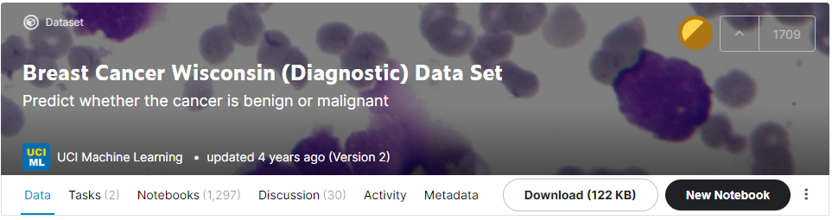
Data Source(1)
https://www.kaggle.com/uciml/breast-cancer-wisconsin-data
The data used for this POC is from University of Wisconsin.
Citation: This breast cancer databases was obtained from the University of Wisconsin Hospitals, Madison from Dr. William H. Wolberg.

Slide 5
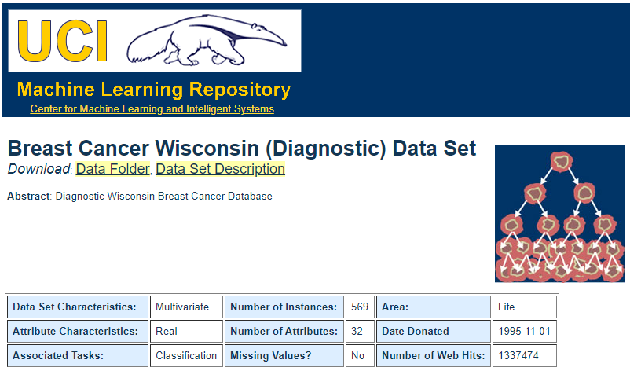
Data Source(2)
https://archive.ics.uci.edu/ml/machine-learning-databases/breast-cancer-wisconsin/
From this site we have to download breast-cancer-wisconsin.data file

Slide 6
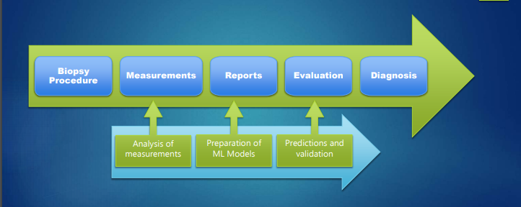
Flow of Data

Slide 7
Data Description(DataSource1)
Features are computed from a digitized image of a fine needle aspirate (FNA) of a breast mass.
They describe characteristics of the cell nuclei present in the image. The mean, standard error, and "worst" or largest (mean of the three largest values) of these features were computed for each image, resulting in 30 features.
For instance, field 3 is Mean Radius, field 13 is Radius SE, field 23 is Worst Radius. All feature values are recorded with four significant digits.

Slide 8
Data Description(DataSource1)
1. ID number 2. Diagnosis (M = malignant, B = benign) 3-32. Ten real-valued features are computed for each cell nucleus: a) radius (mean of distances from center to points on the perimeter) b) texture (standard deviation of gray-scale values) c) perimeter d) area e) smoothness (local variation in radius lengths) f) compactness (perimeter^2 / area - 1.0)
g) concavity (severity of concave portions of the contour) h) concave points (number of concave portions of the contour) i) symmetry j) fractal dimension ("coastline approximation" - 1)

Slide 9
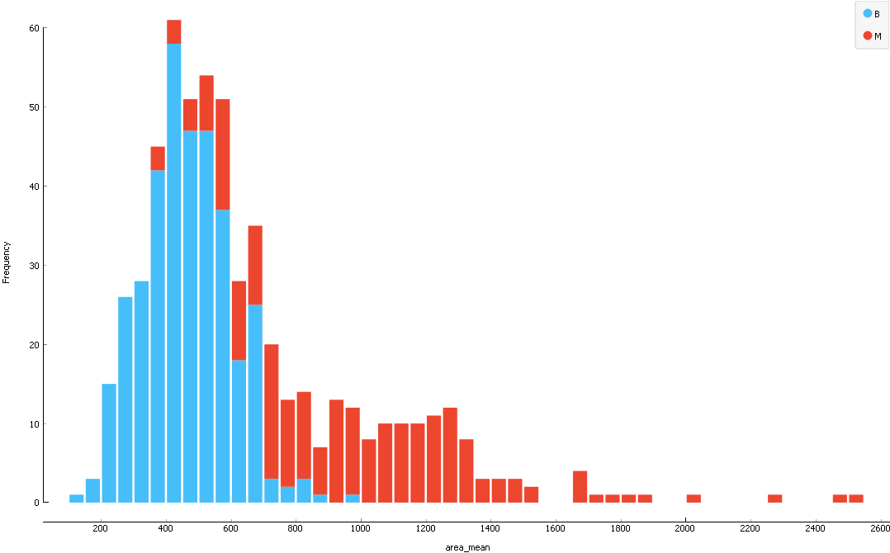
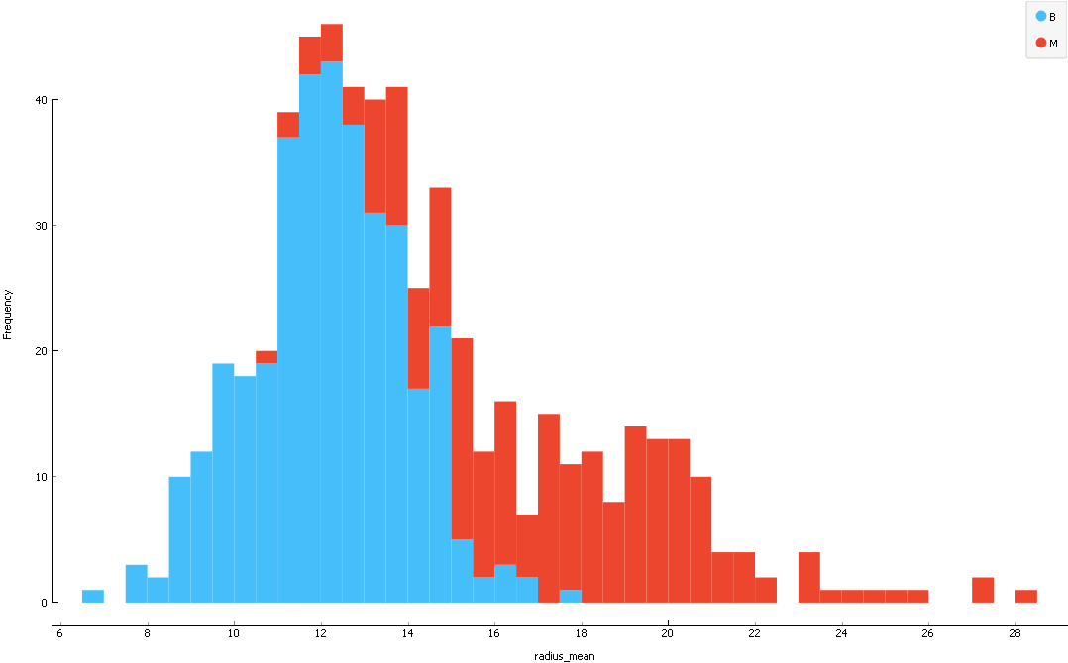
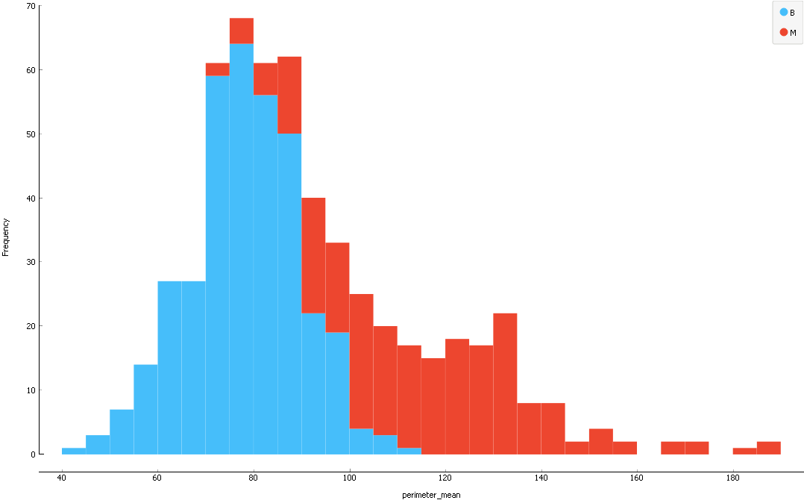
Area Mean
Mean Radius, Mean Perimeter and Mean Area appear to be helpful in classification.
Higher the values of each parameter more are the chances of it being malignant.
Radius Mean
Perimeter Mean

Slide 10
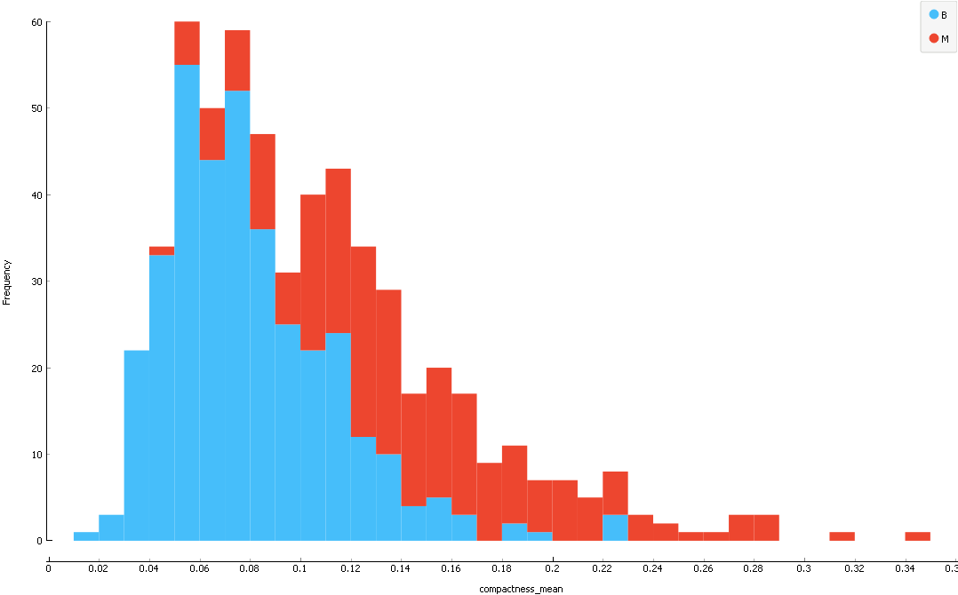
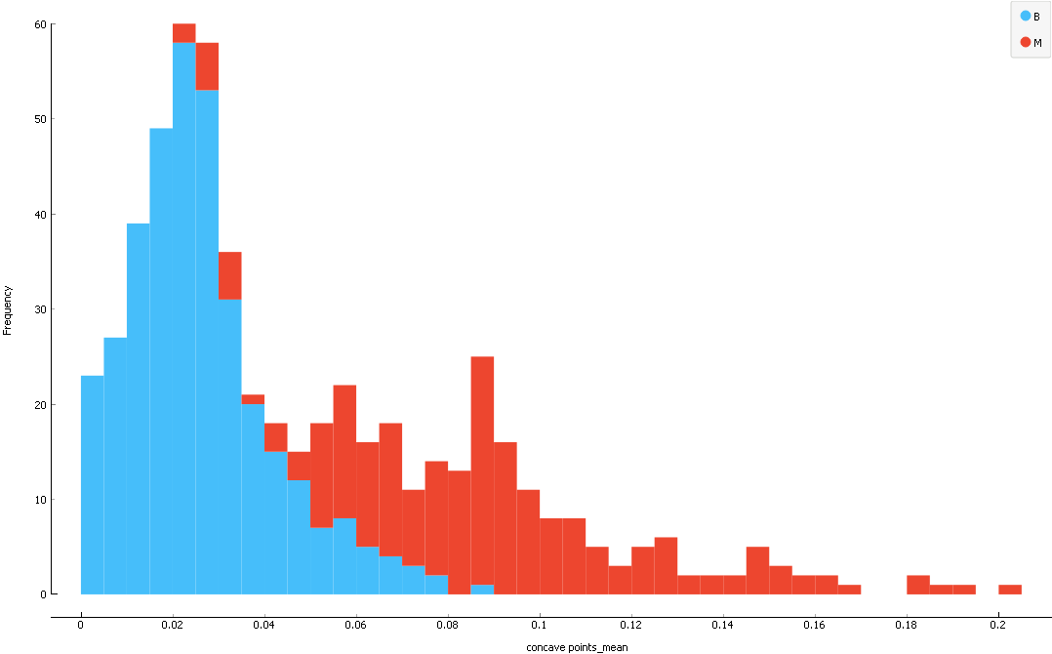
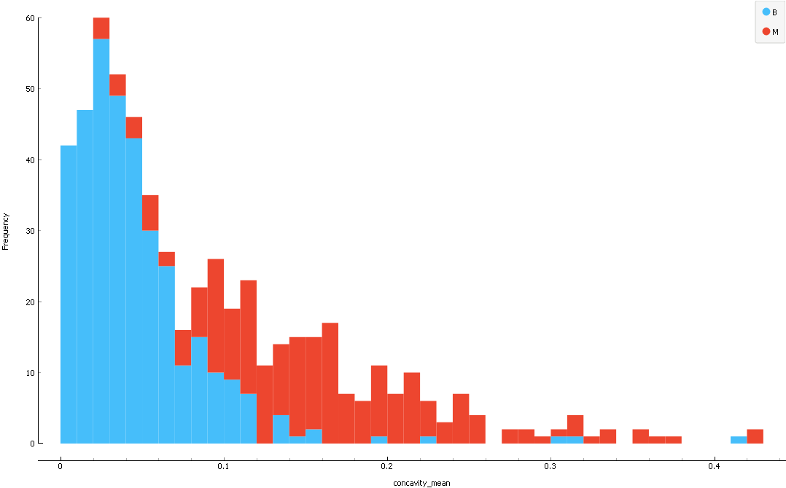
Mean Compactness
Mean Concavity, Mean Concave , and Mean Compactness appear to be helpful in classification.
Higher the values of each parameter more are the chances of it being malignant.
Mean Concave
Mean Concavity

Slide 11
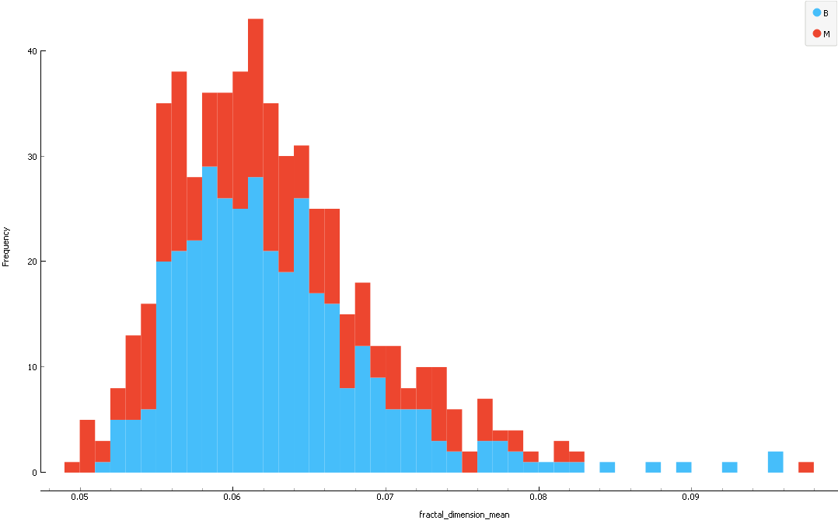
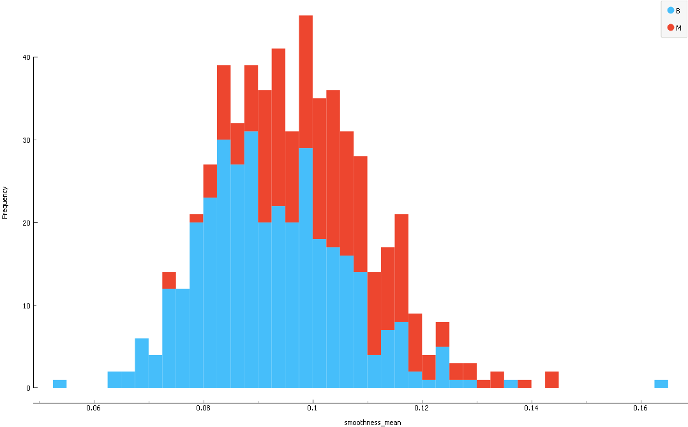
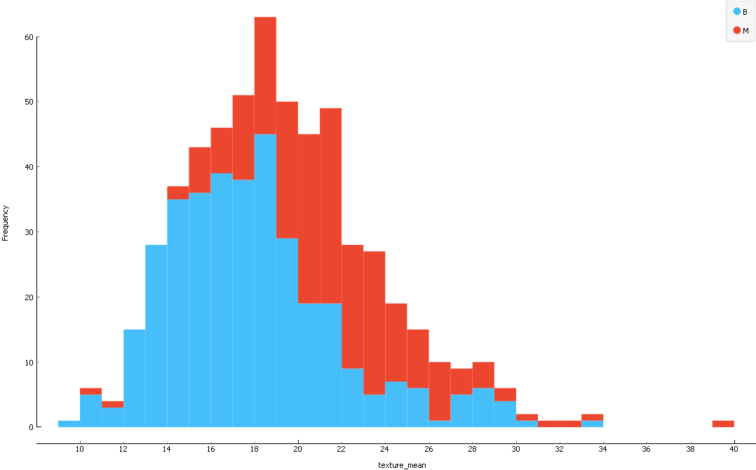
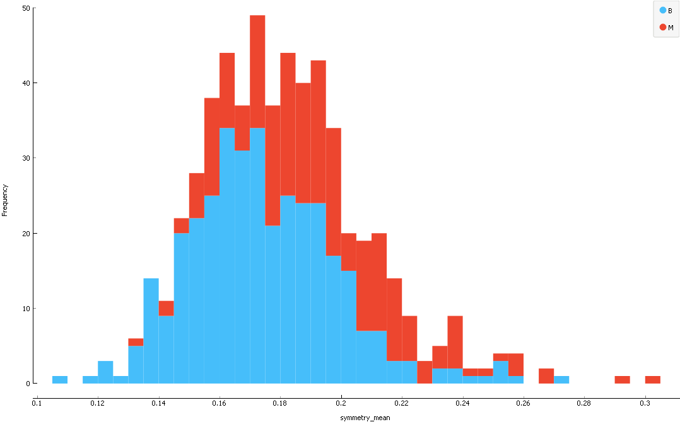
Mean smoothness
Mean Fractal Dimension
Mean Smoothness, Mean Texture, Mean Fractal Dimension, Mean Symmetry and Mean Compactness do not appears to have influence on classification.
Here Both the classes are spread across
Mean Symmetry
Mean Texture

Slide 12
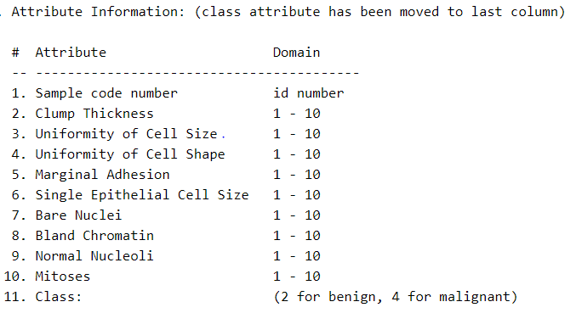
Data Description(DataSource2)

Slide 13
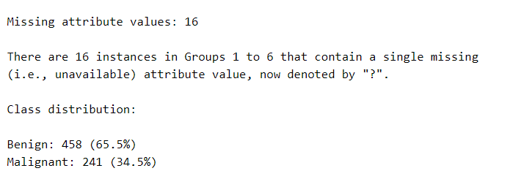
Data Description(DataSource2)

Slide 14
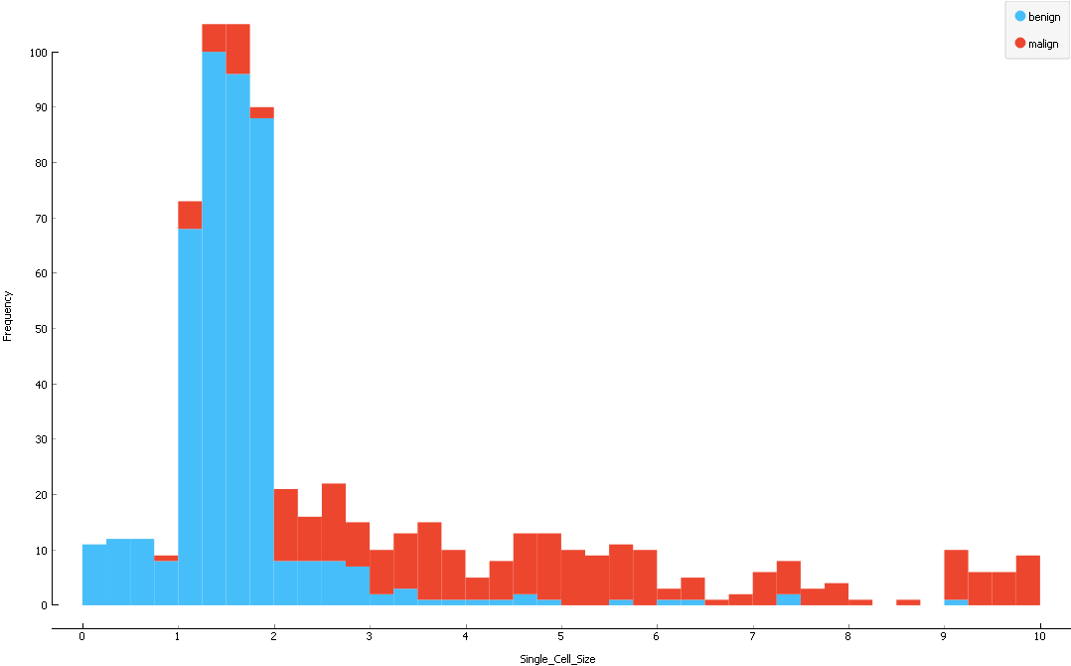
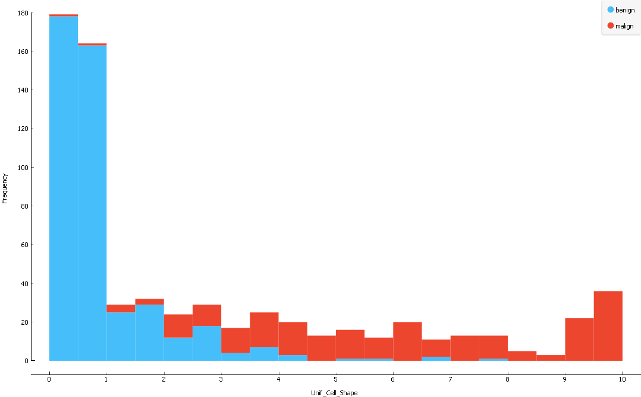
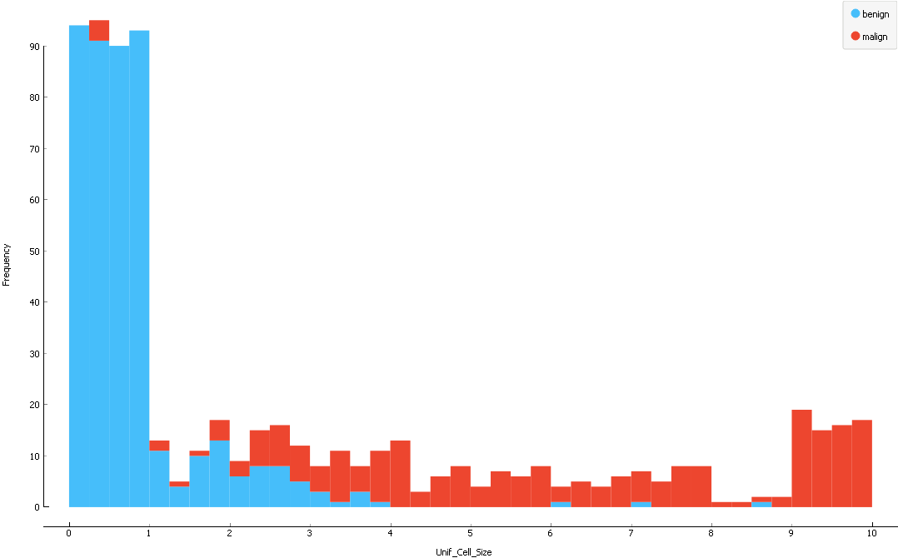
Data Description(DataSource2)
Single Epithelial Cell Size
The features distinguish between benign and Malignant fairly well.
Cell Size
Cell Shape

Slide 15
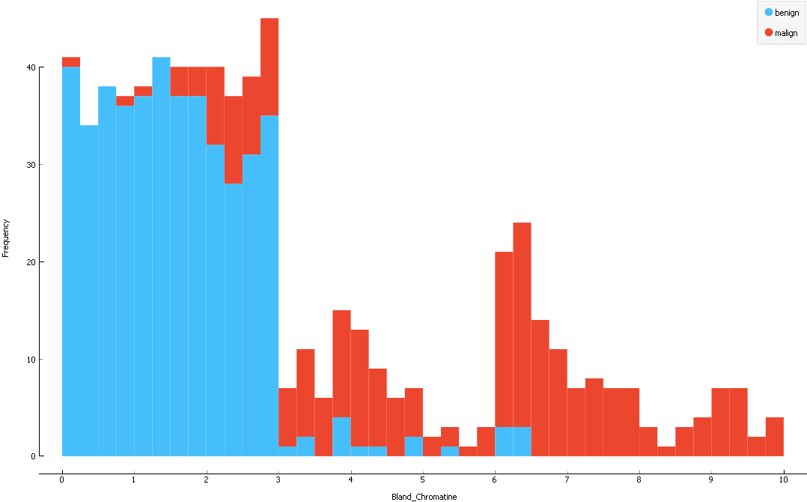
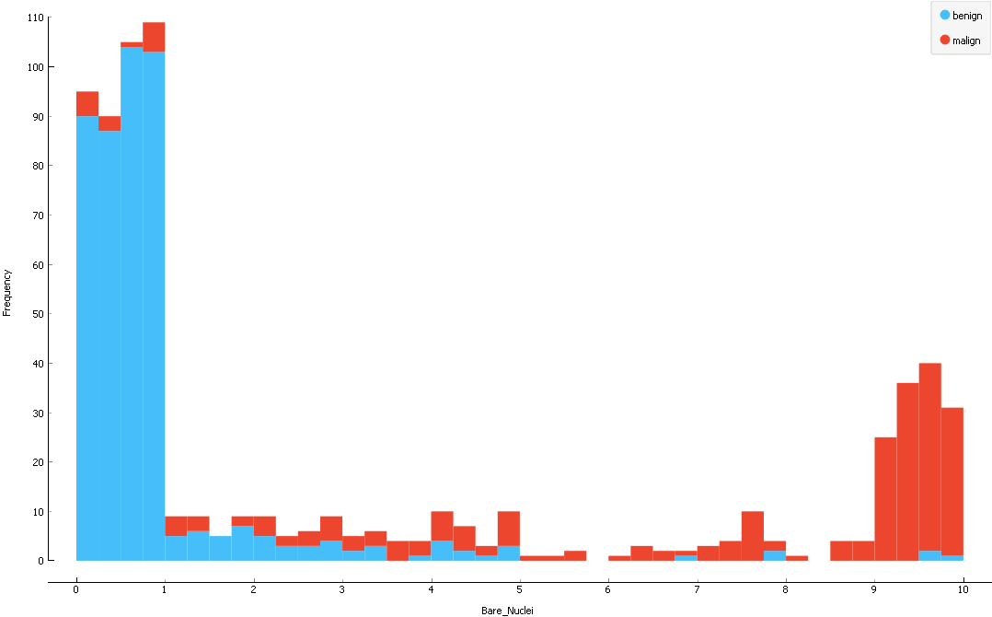
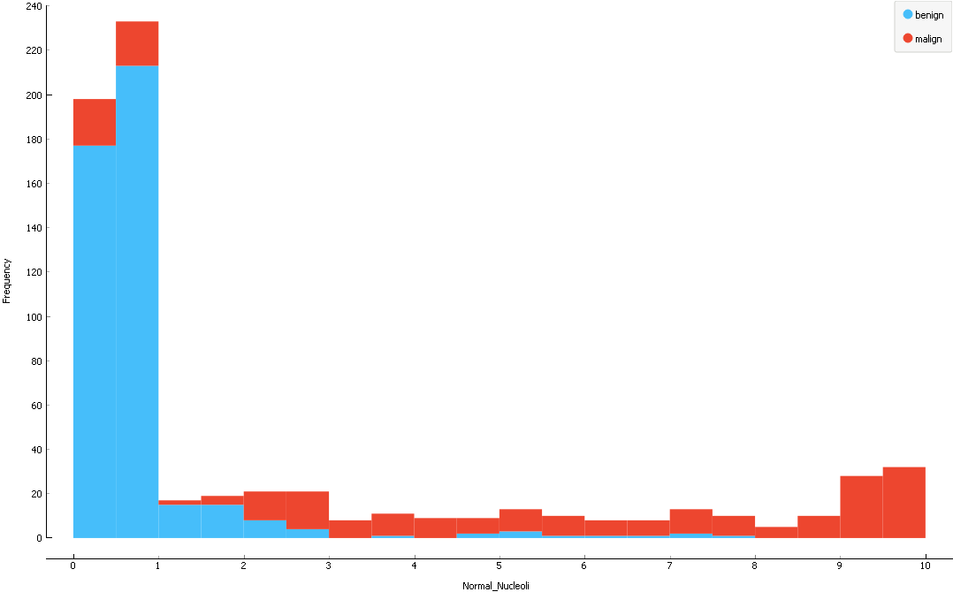
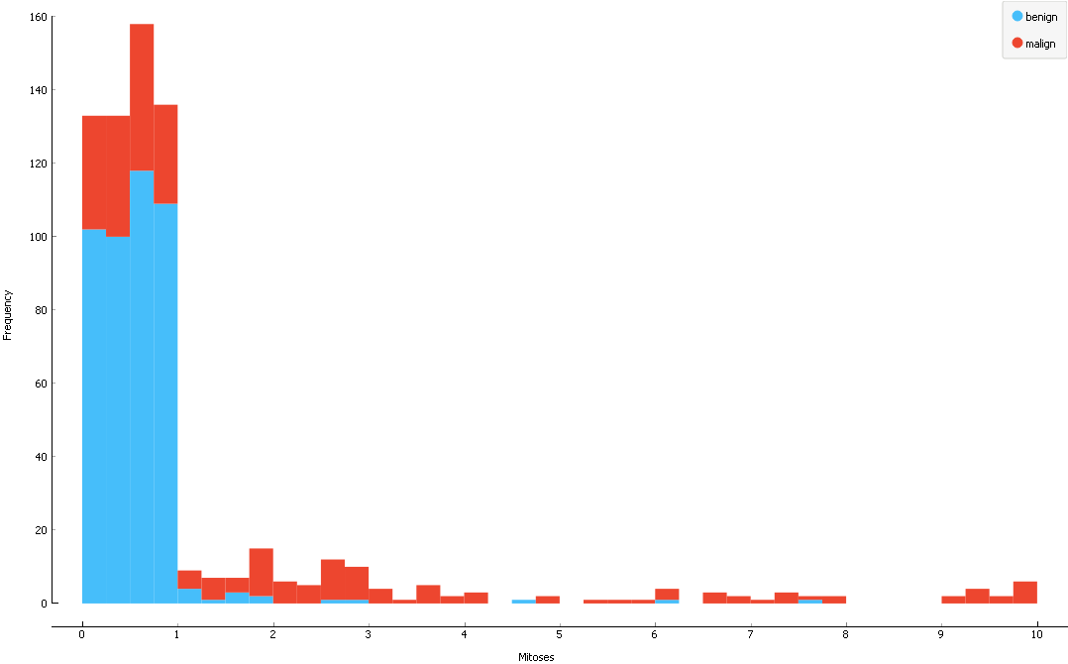
Bland Chromatin
Bare Nuclei
Normal Nucleoli
Mitoses

Slide 16
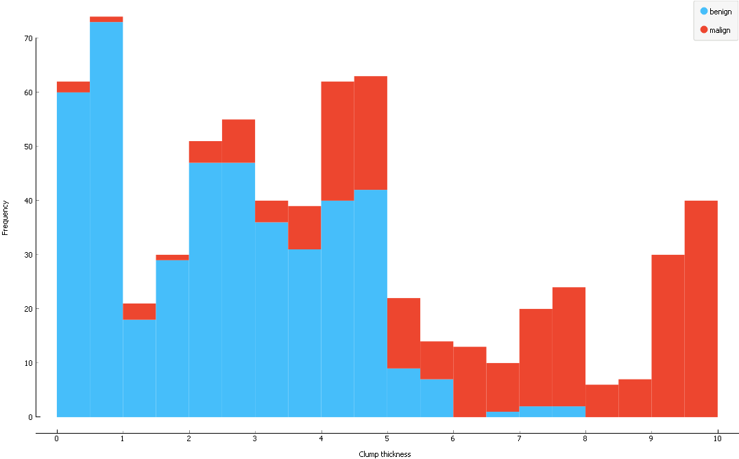
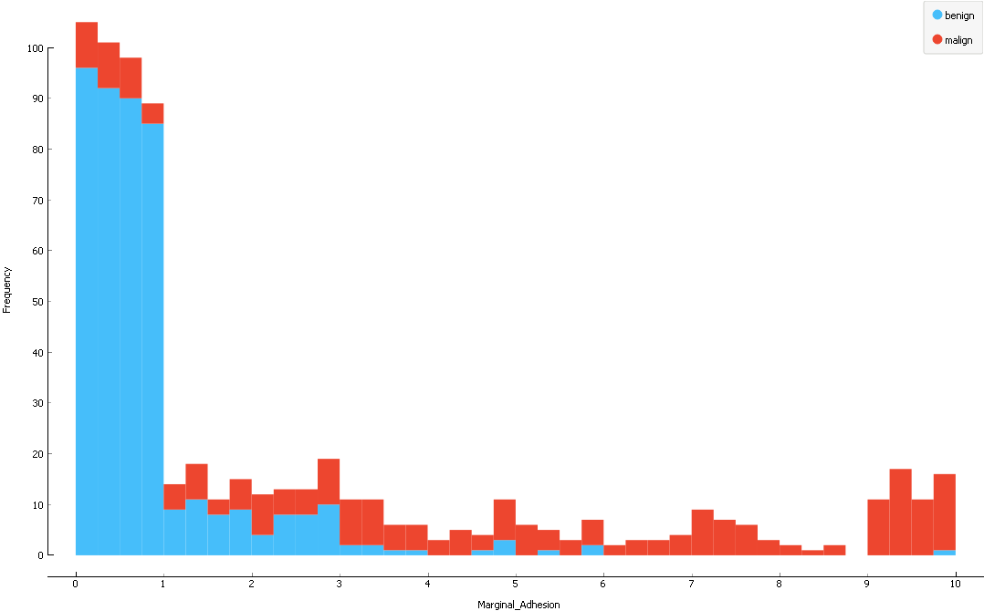
Clump Thickness
Marginal Adhesion

Slide 17
THANK YOU

